Slide 1
PROCESS COSTING
(Weighted Average & FIFO Methods)
Yunus Emre KÖKLÜ

Slide 2
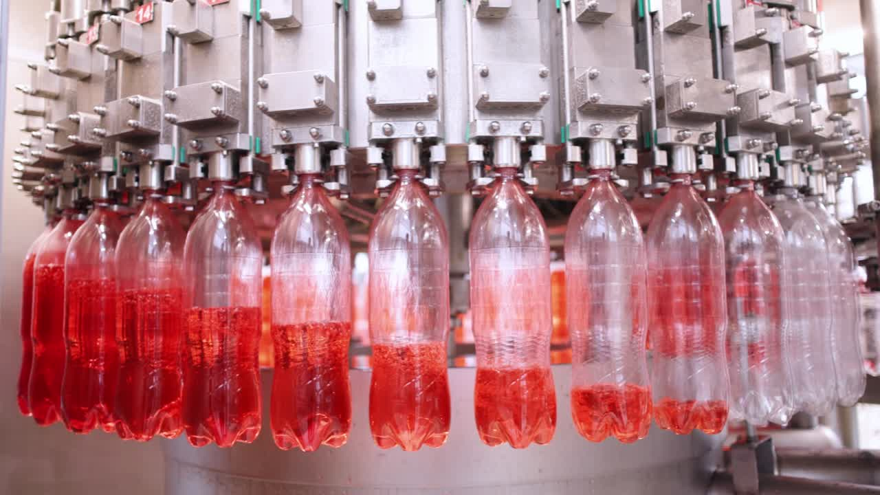
What Is Process Costing?
Used in systems with continuous and mass production
Products are identical or very similar
Costs cannot be tracked per unit → average cost is used
Production flows department by department
Each department adds its own cost
Examples:
Soda manufacturing
Detergent production
Paint, cement, plastic production

Slide 3

Why Do We Use Process Costing?
At any time, products are at different stages of completion
Partially completed work must be included in cost
Cannot calculate cost per individual unit → use Equivalent Units of Production (EUP)
Helps management:
Determine unit cost
Evaluate departmental efficiency
Control production

Slide 4

The Logic of Equivalent Units
Equivalent Units:
“How many fully completed units’ worth of work has been performed?”
Calculated separately for:
Materials
Conversion (labor + overhead)
Daily Life Example:
You painted 80 walls
20 walls are 50% done
→ 80 + (20×0.50) = 90 equivalent units

Slide 5

Weighted Average Method (4 Steps)
Flow of physical units:
Total units in = total units out
Equivalent units:
Completed → always 100%
Ending WIP → percentage given
Cost per equivalent unit:
Total cost ÷ total equivalent units
Cost assignment:
To units completed
To ending WIP

Slide 6

FIFO Method Logic
FIFO principle:
“Do not mix last month’s costs with this month’s.
Only this month’s work is measured with this month’s cost.”
FIFO separates units into three groups:
Units in beginning WIP that must be finished
Units started and completed this month
Units in ending WIP
FIFO measures only the work done this period.

Slide 7
FIFO vs. Weighted Average
Feature | Weighted Average | FIFO
Prior period costs | Combined with current | Kept separate
EUP calculation | All units together | Three groups (beginning / started / ending WIP)
Usage | Simpler production environments | When costs fluctuate
Complexity | Easier | More detailed

Slide 8
Problem (Weighted Average)
Production Data – Painting Department
Beginning WIP: none
Started: 6,000 units
Completed: 4,500 units
Ending WIP: 1,500 units (materials 100%, conversion 30%)
Costs:
Materials: 30,000 $
Conversion: 18,000 $
Required:
Equivalent units
Cost per equivalent unit
Cost of completed units
Ending WIP cost

Slide 9
Solution (Weighted Average) – Page 1
1) Equivalent Units
Materials:
Completed: 4,500 × 100% = 4,500
Ending WIP: 1,500 × 100% = 1,500
→ 6,000 equivalent units
Conversion:
Completed: 4,500 × 100% = 4,500
Ending WIP: 1,500 × 30% = 450
→ 4,950 equivalent units
2) Cost per Equivalent Unit
Materials: 30,000 / 6,000 = 5 $
Conversion: 18,000 / 4,950 ≈ 3.64 $

Slide 10
Solution (Weighted Average) – Page 2
3) Cost of Completed Units
Materials: 4,500 × 5 = 22,500
Conversion: 4,500 × 3.64 ≈ 16,380
→ Total ≈ 38,880 $
4) Ending WIP Cost
Materials: 1,500 × 5 = 7,500
Conversion: 450 × 3.64 ≈ 1,638
→ Total ≈ 9,138 $

Slide 11
Problem (FIFO)
Production Data – Mixing Department
Beginning WIP: 2.000 units (40% conversion complete)
Units started: 5.000
Units completed: 5.000
Ending WIP: 2.000 (conversion 30%)
Costs:
Beginning WIP: materials 4.000 ; conversion 2.000
Costs added this period: materials 12.000; conversion 9.000
Required:
FIFO equivalent units
Current-period cost per equivalent unit
Cost to complete beginning WIP
Cost of units started & completed
Ending WIP cost

Slide 12
Solution (FIFO) – Page 1
1) Equivalent Units – FIFO
Finishing beginning WIP:
60% needed → 2,000 × 60% = 1,200 conversion EUP
Units started & completed:
Completed 5,000 – beginning 2,000 = 3,000 units
→ Materials: 3,000
→ Conversion: 3,000
Ending WIP:
Materials: 2,000 × 100% = 2,000
Conversion: 2,000 × 30% = 600
Total FIFO EUP:
Materials = 3,000 + 2,000 = 5,000
Conversion = 1,200 + 3,000 + 600 = 4,800
2) Cost per Equivalent Unit
Materials: 12,000 / 5,000 = 2.40 $
Conversion: 9,000 / 4,800 ≈ 1.88 $
3) Cost to Complete Beginning WIP
Prior costs:
Materials: 4,000
Conversion: 2,000
Costs added this period:
Materials: 0
Conversion: 1,200 × 1.88 ≈ 2,256
→ Total ≈ 8,256 $

Slide 13
Solution (FIFO) – Page 2
4) Cost of Units Started & Completed (3,000 units)
Materials: 3,000 × 2.40 = 7,200
Conversion: 3,000 × 1.88 ≈ 5,640
→ Total ≈ 12,840 $
5) Ending WIP
Materials: 2,000 × 2.40 = 4,800
Conversion: 600 × 1.88 ≈ 1,128
→ Total ≈ 5,928 $

